Slide 1
Plate Tectonics
How big are the plates of the Earth? Are they all the same?
How do they move?
Where do they move?
What happens when they move?

Slide 2
Major PlAtes of the Earth’s Crust

Slide 3
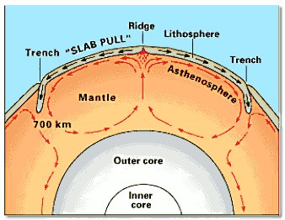
How they Move
Tectonic plates move or float on top of the asthenosphere
The plates are forced in specific directions by the flow of magma beneath. Just like a boat caught in a current plates move with the flow of magma.
Analogy: Convectional oven.

Slide 4
The discovery

Slide 5
Movement
Do the plates all move in the same direction?
Do they all move in the same manner?
NO!

Slide 6
Types of movement
1. Compressional/ Convergent Forces occur where two tectonic plates come together. They compress against each other.
Subduction Zones sometimes occur where compressional forces result from two plates colliding.

Slide 7
Compression

Slide 8
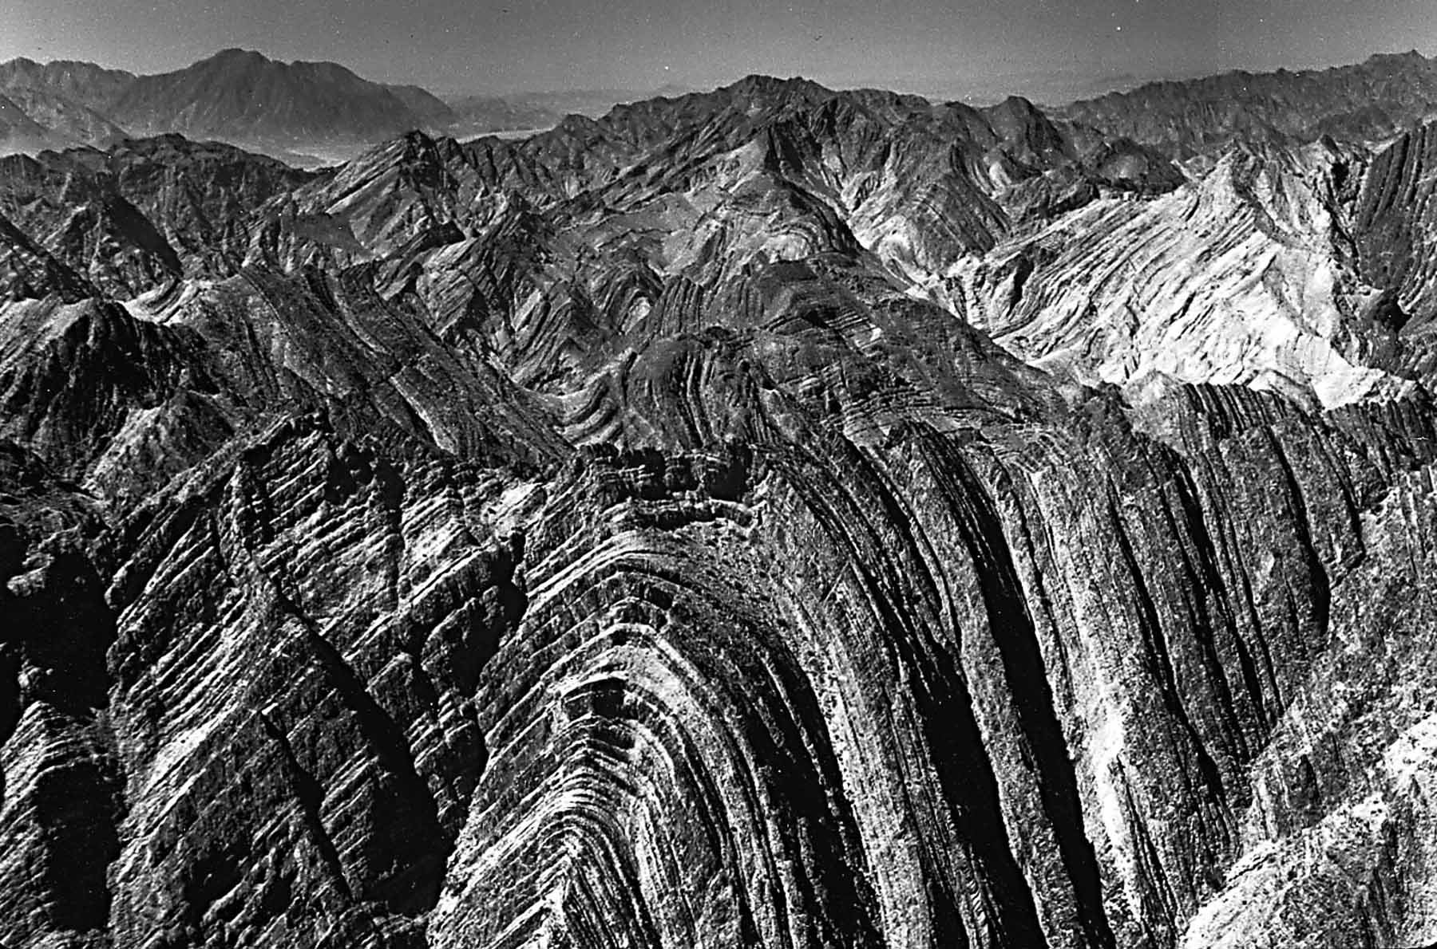
Compression

Slide 9
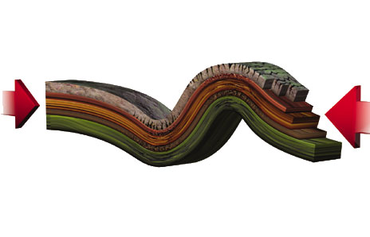
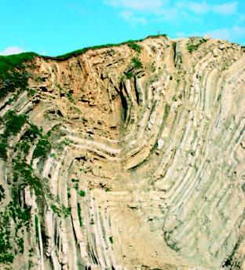
Compression

Slide 10
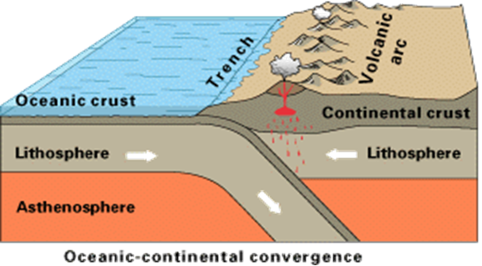
Subduction Zones
What happens at subduction zones?
One plate slides under another plate
Oceanic plate goes under continental plate (usually)
Continental plate bunches up into islands or mountains
Volcanoes are caused on surface by friction and melting of the subducting plate

Slide 11
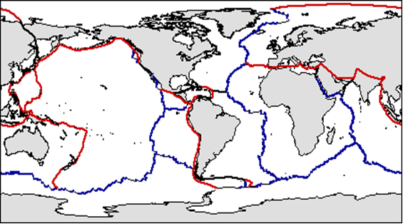
Subduction Zones
Subduction zones of the world are in red:

Slide 12
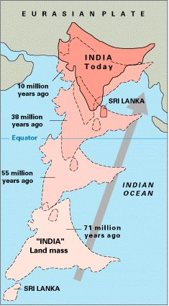
EX: MT. EVERST
This is how Mt Everest is still growing. India still hasn’t ceased movement into the rest of Asia. Note the time reference (it takes a long time to “move”)

Slide 13
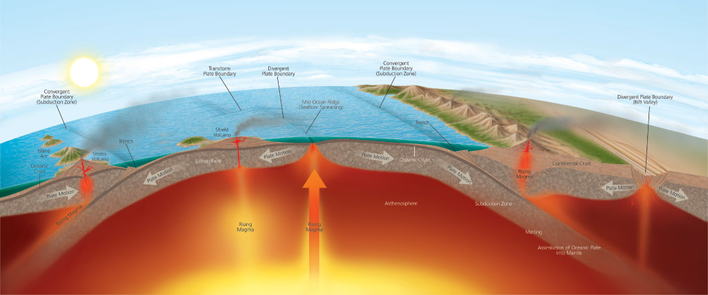
Types of Movement
2. Tensional/Divergent Forces occur where two tectonic plates are pushed apart. The tension is created as the plates move away from each other.

Slide 14
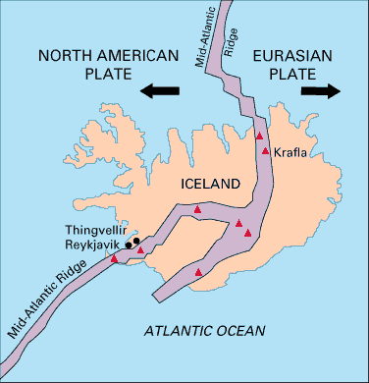
Tension
The Result: Ridge Zones sometimes occur where two plates move apart. The magma rises between the plates and forms a ridge
EX:
Iceland

Slide 15
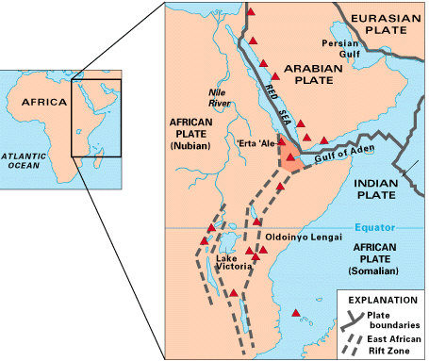
Tension
EX: East African Rift Zone:
historically active volcanoes(red triangles)
triple junction where three plates are pulling away from one another

Slide 16
Tension
Ridge Zones are in Blue:

Slide 17
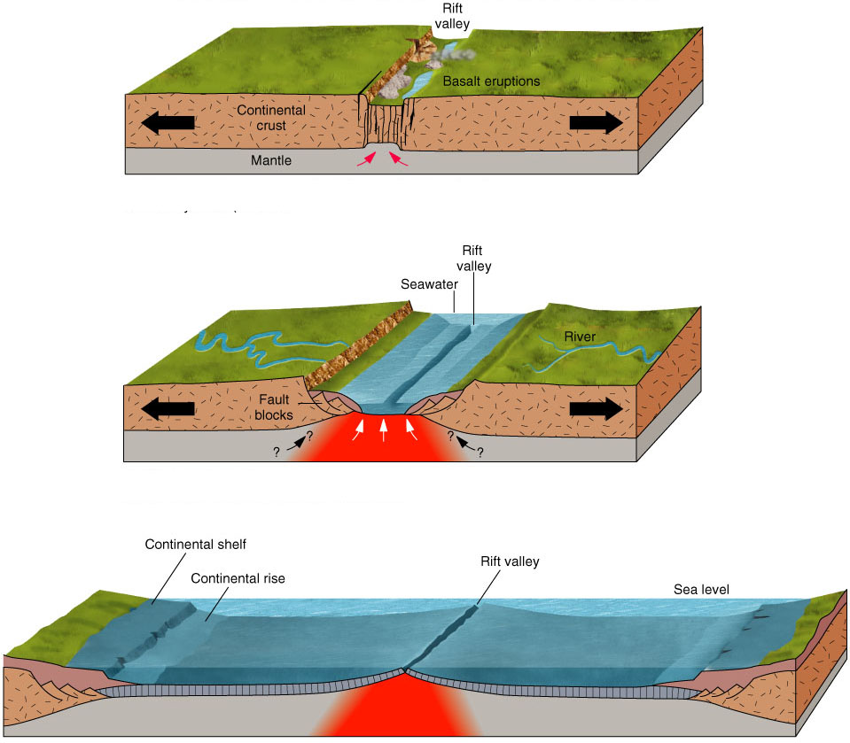
Tension

Slide 18
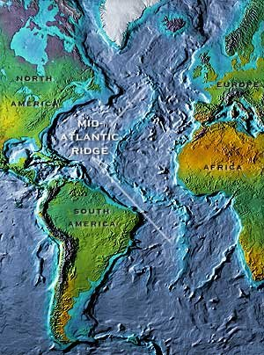
Mid-Atlantic Ridge zone

Slide 19
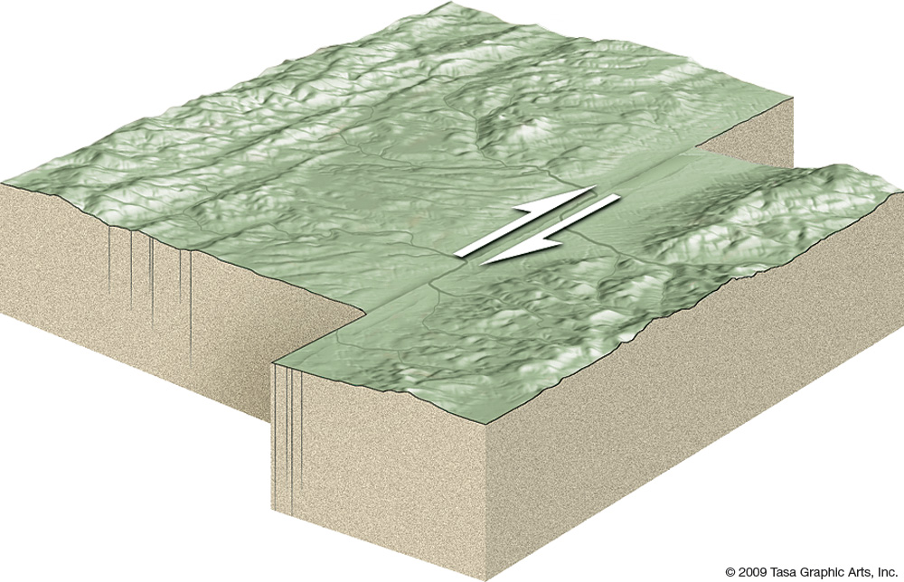
Transform boundaries
3. Transform Boundaries are when two plates move in opposite directions laterally /horizontally (note diagram below)

Slide 20
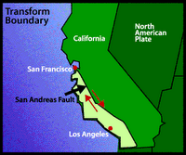
Transform Boundaries

Slide 21
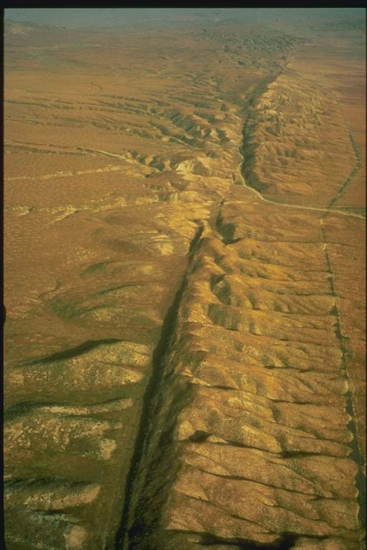
San Andreas Fault, CA

Slide 22
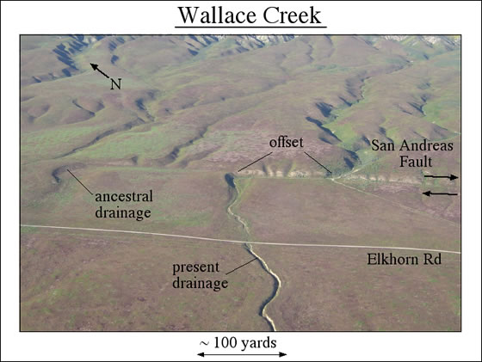
San Andreas Fault SLips

Slide 23
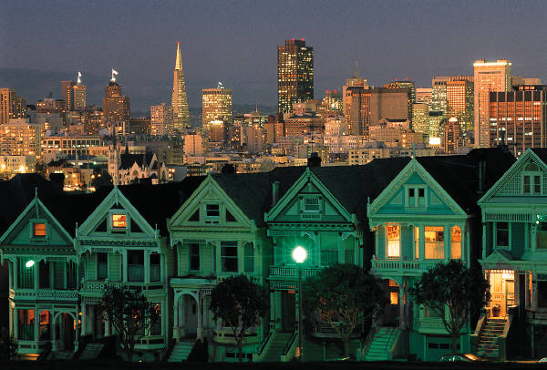
San Andreas Fault Slips
Video:

Slide 24
Tectonic zones
Notice that subduction zones occur where the tectonic plates are moving towards each other while Ridge zones occur where the plates are moving apart.

Slide 25
Ring of Fire

Slide 26
World’s Mountain Ranges

Slide 27
Ring of fire vs. Mountain Ranges
What are the similarities between the boundaries?

