Slide 1
The Northwest Changes

Slide 2
Review
Who are the 2 fur trade companies operating in the Northwest?
What business model was superior within the fur trade?
What new populations come into being as a result of the fur trade?

Slide 3
Recall Fur Trade and Settlement Rivalries
The fur trade was one of the most important industries on the North American continent
The quest for furs pushed les coureurs de bois (later the voyageurs) and the Baymen progressively further west
HBC is based along Hudson’s Bay
NWC is based in Montreal along the St. Laurence
Competition is bitter, fierce, and sometimes violent
NWC model gave them a competitive advantage
The company motto is Perseverance
The competition benefits First Nations
These traders led expansion into what is now western Canada

Slide 6
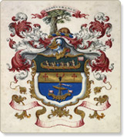
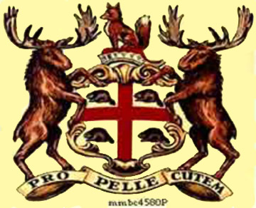
Rivalry
HBC
NWC

Slide 7
The Selkirk Settlement
As the HBC and NWC travel and explore the West, European settlement begins
This would forever alter the lives of First Nations and Metis who lived there

Slide 8
Thomas Douglas, 5th Earl of Selkirk
He was born in Scotland in 1771 the 7th son of a wealthy landowner
As the 7th son he would not inherit the family fortune, so he was sent to law school where he focuses his attention on the poor tenant farmers who had been removed from their land by wealthy landowners
During this time his father and brothers had unexpectedly died of disease, so he inherited the family title and fortune
He then used his money and titled to help displaced Scottish farmers through emigration to B.N.A.
Selkirk asked the British government to grant him a section of land in the Red River Valley that was part of Rupert’s Land, but was refused because of the HBC monopoly
So, Selkirk bought enough shares in the HBC to gain influence within the Company and subsequently purchased 40, 468 hectares of land which became know as the Selkirk Concession of Assiniboia

Slide 16
Assiniboia’s Population Mix
Selkirk hired Miles MacDonell (Scottish born North American) to arrange for immigrants to come to the colony
The 1st group arrives in 1812 (36 Scottish and Irish workers
They spent the first 2 winters at the HBC post at Pembina, ill equipped for the rugged landscape and harsh winters
They were assisted by Chief Peguis’s Saulteax People and the Metis
They gave them food and helped them adapt
Without this help, few would have survived
The settlement grew slowly as immigrants from Scotland and Ireland arrived

Slide 17
Chief Peguis

Slide 18
Red River Valley Population pre-Selkirk
The area was already populated by Metis (the majority) and Ininimowin (Swampy Cree) and Saulteaux peoples as well as Canadiens in St. Boniface in the east bank of the Red River
There were also French, Scottish, and Orkney men who had been employed in the fur trade, many of whom had First Nations wives and Children

Slide 20
Selkirk Immigrants
Selkirk immigrants were distinct from Red River’s existing populations
Selkirk Settlers relied mainly on farming, and did not intermarry with First Nations
The Selkirk colony had to establish a successful, self sufficient colony, establish good relations with the rival HBC and NWC, and live alongside the Metis and First nations people who were wary of newcomers
The NWC did not welcome them and believed the Selkirik land grant to be a plot by the HBC to ruin NWC trade in the area
The colony was situated right across the major river routes that the Nor’Westers used to transport pemmican from the bison rich prairies to northern posts
This conflict escalated over time

Slide 21
The Metis at Red River
Reminder: the Metis culture was a result of the fur trade and the intermarriage between French fur traders and First Nations wives
The Metis at Red River grew to have a culture that was representative of their mixed ancestral background as well as their geographical setting
Many Metis men worked guides or voyageurs eventually for the NWC
Over time the Red River Settlement became home for many Country-born families who were connected to the HBC
Reminder: The Country-born were the children of British Baymen and First Nations wives
After 1870, many Country-born families became considered Metis

Slide 22
Metis vs. Country Born
Metis
Country-born
Roman Catholic
Depend mostly on the fur trade and buffalo hunt for their livelihood
Protestant
Relied mostly on farming
Some did rely on fur trade and hunting as well

Slide 23
Metis Government
The buffalo hunt was so important that the Metis formed a government to oversee each hunt
A captain was elected to lead
Under the captain, a council of lieutenants was elected to represent the hunters
Hunts were carried out with military-like precision
Strict rules were necessary to manage the large number of hunters

Slide 24
The Red River Cart
First appeared in Pembina (1 of the 2 colonies at Red River) in 1801
Red River Carts were large, 2 wheeled, made with wood tied together with leather, pulled by oxen or horses
Well suited for the prairies
Easily repaired
Wheels could move through mud and marsh
Buoyant (could be floated across streams and rivers)
The carts were closely associated with the Metis
They were first used to bring back meat from the buffalo hunt
Later used for trade and large brigades travelled long distances throughout the Northwest
The carts became an instrumental part of the development of the Northwest

Slide 28
The Pemmican Proclamation
By 1810 the Metis are the main providers of pemmican and other bison products to the NWC in Red River
On the other hand, the Selkirk settlers experienced food shortages due to crop failures and begin hunting bison
The Metis now see the Settlers as a threat their place in the fur trade, their territory, and their livelihood (bison hunt)
On Jan 8th, 1814, Miles MacDonnell (governor of the colony) issues a ban on the export of any food (notably pemmican) from Red River in an attempt to ensure adequate provisions for immigrants into the colony
This profoundly affects the Metis and the NWC traders in Red River
The Metis relied on pemmican as an integral part of their economy
The NWC relied on pemmican to supply its posts with an essential food source

Slide 31
Let’s Think…
Even prior to the Pemmican Proclamation, how might the Metis have perceived the Selkirk Colonists?
Even prior to the Pemmican Proclamation, how might the NWC have perceived the Selkirk Colonists?
What affect will the Proclamation have on both of these populations?
What may be the result of the Proclamation in Red River?
Could the proclamation be about more than just the securing food sources for the colony?
Who stands to benefit from the Proclamation?

Slide 32
The Pemmican War
It begins when HBC employees begin searching NWC forts and seizing pemmican
The Nor’Westers retaliated by arresting and imprisoning the HBC men for burglary, but also destroyed the crops and razed (destroyed) the buildings of Selkirk immigrants near Fort Douglas
Together, the Metis and the NWC were determined to drive the Selkirk immigrants from the colony
They took farm equipment and horses and threatened the colonists
In the summer of 1815, the colony is in shambles and all but 3 colonists had fled (however, another group arrived shortly)
Skirmishes continued for several years
In 1815 MacDonnell resigned as governor and is replaced by Robert Semple

Slide 33
Let’s Think…
MacDonnell’s legacy:
MacDonnell is considered a hero by some. There is a school right her in Winnipeg named in his honor
By issuing the Pemmican Proclamation MacDonnell caused suffering among the Metis and Nor’Westers and incited violent conflict, in order to help the new colony survive
Were his actions justifiable? Why or Why not?

Slide 34
Also…
How does the HBC figure into all of this?

Slide 36
The Battle of Seven Oaks
In the spring of 1816 Semple gave the command for the HBC to capture and burn Fort Gibraltar, and NWC fort near Fort Douglas
To the Metis and NWC this is an act of war
Cuthbert Grant (the son of a Metis mother and Scottish father) was a Metis leader
On June 19, 1816 Grant and a party of 60 men (40 Metis) travel along the Assiniboine towards the Fort, then on foot to a cluster of trees known locally as Seven Oaks
Semple and about 27 HBC men and colonists were waiting for them
After an exchange of words a gunfight broke out
Within 15 minutes Semple and 20 of his men were dead and the Metis lost 1 man
Grant sends an HBC survivor ahead to demand the surrender of the Fort which was given up shortly after
The Battle for Seven Oaks highlighted the struggle between the HBC and NWC for control over the fur trade

Slide 37
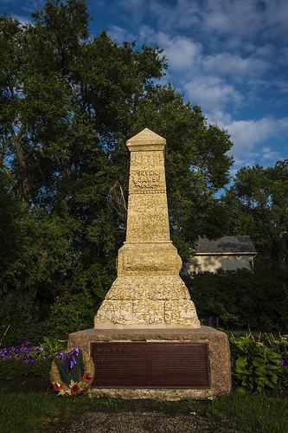

Slide 39
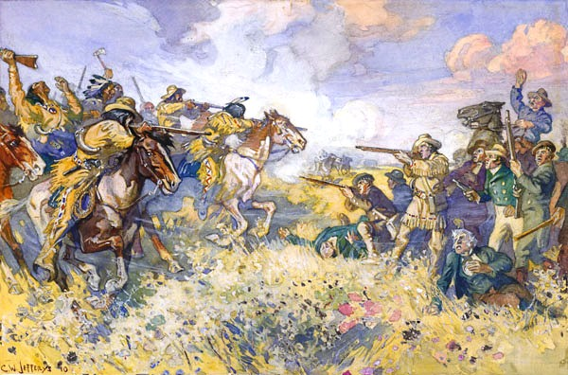

Slide 40
Let’s Think…
This confrontation goes by 2 names:
The Battle of Seven Oaks
The Massacre of Seven Oaks
Why the two names?
What determines its title?

Slide 41
After Seven Oaks
When hearing of the battle at Seven Oaks Lord Selkirk was en route to the colony with his own private army
In retaliation Selkirk captured Fort William (present day Thunder Bay) the heart of the NWC fur trade empire
Selkirk winters at Fort William and head towards Fort Douglas in the spring, capturing NWC forts along the way
The NWC seize HBC forts in the Athabasca territory in retaliation
The war continues in this manner for 5 years
Despite this, the Selkirk colony continues to grow slowly
The Metis remained the vast majority of the population, however and multicultural society was developing

Slide 42
A Historic Merger
The HBC / NWC conflict which had grown since the establishment of the NWC ends in 1821 with a historic merger
The name HBC is retained and company became the most powerful fur-trade organization in N.A.
Why? Economics.
The competitive push westward in addition to the NWC model of long travel back to the St Laurence was expensive
The HBC costs were high as well with expansion into the West, however they had access to long-term credit from the Bank of England
The NWC did not have access to this and constantly had to find new sources of revenue to fund expansion. It was unsustainable

Slide 43
Changes in the Fur Trade
The HBC / NWC merger was the beginning of many changes
The beaver was severely depleted due to over-hunting and poor conservation
New ways of treating other furs made them suitable to producing felt
At the same time, the felt hat was being replaced by the top hat made of silk

Slide 44
Decline of the Fur and Bison Trade
As the beaver fur trade declines, so do the employment opportunities for Metis in the fur trade, so many Metis previously employed in the fur trade began to focus on another product: the bison robe
A large cured bison hide with the hair left on. It was used as a blanket or wrap
Bison hides also had other uses like making belts and other leather products
The Metis not only hunted the bison, but also became middle men, purchasing robes from First Nations, and reselling them to the HBC, or companies in the US
Driven by the large demand in the US prices for the buffalo robe spiked
Bison were killed by the thousands, driving the species to the edge of extinction
The population was also affected by the building of a transcontinental railway in the US which cut off migration paths and transported American and European sport hunters to the Northwest

Slide 45
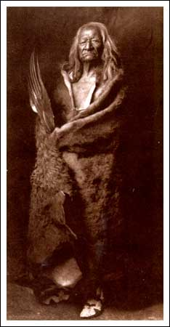

Slide 48
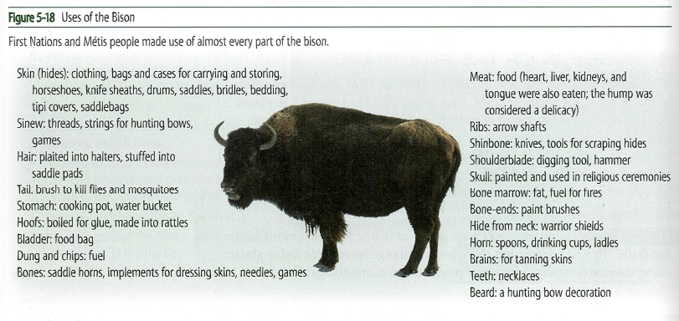

Slide 49
Let’s Think
Poor conservation in favor of all out economic gain is partly to blame for the disruptions to the fur trade
What parallels are there between today’s economy and this era vise a vie society’s treatment of the environment?

Slide 50
The 49th Parallel cont’d
Throughout the mid-to-late 19th century Canada and the US had an often tumultuous relationship
Much of the conflict centered on expansion, with the West increasingly becoming an area of contention
During the 1820s and 1830s joint control over the region worked
The British called it the Columba District (controlled by the HBC)
The US called it Oregon Country
But in 1844 US presidential candidate ran on a platform of annexing the entire region and won the election
In 1845 joint control ends and in 1846 the Oregon Treaty came into law res-establishing the 49th parallel as the border (except where it dipped for Vancouver Island)
Following the Treaty British officials required the HBC to set up a colony on Vancouver Island (declared in 1849) and the colony of British Columbia was declared in 1858
The HBC encouraged British settlement and had control over the land and resources

Slide 51
Dispossession of First Nations
2 major events had a significant impact on First Nations in the Pacific North West
The most intense period of fur trade activity occurred between 1821 and 1840
The gold rush lasted about a decade (~1858-1866)

